Slide 1
Programming II
(C Programming Language)
Recursion and Error Handling in C
Lecture 22, Wednesday April 28, 2021
Dr. Ayman ALJARBOUH

Slide 2
Outline
Recursion in C Programming
Divide by Zero Errors
Error Handling in C Programming
Global Variable errno
perror() and strerror()
Program Exit Status

Slide 3
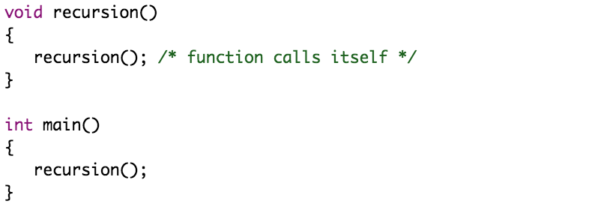
Recursion in C Programming
Recursion is the process of repeating items in a self-similar way
That is, recursion is the technique in which a function calls itself; in this case we call such function a recursive function
Recursion works as follows:

Slide 4
Recursion in C Programming
Recursive functions are very useful to solve many mathematical problems like to calculate factorial of a number, generating Fibonacci series, etc
Note that:
The recursion continues until some condition is met to prevent it
Programmers need to be careful to define an exit condition from the function, otherwise it will go in infinite loop
To prevent infinite recursion, if...else statement (or similar approach) can be used where one branch makes the recursive call, and other doesn’t
Recursion makes program elegant. However, if performance is vital, use loops instead as recursion is usually much slower

Slide 5
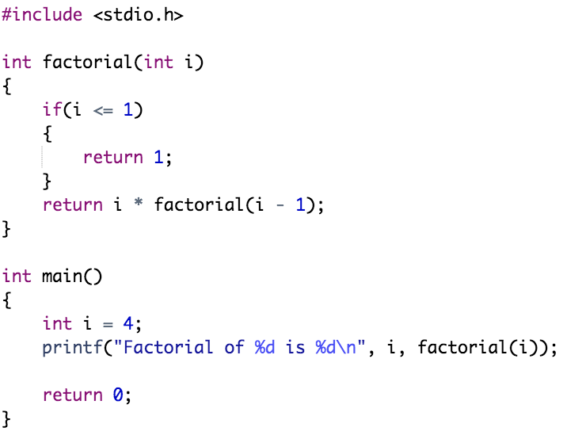
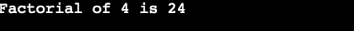
Recursion in C Programming
Example:

Slide 6
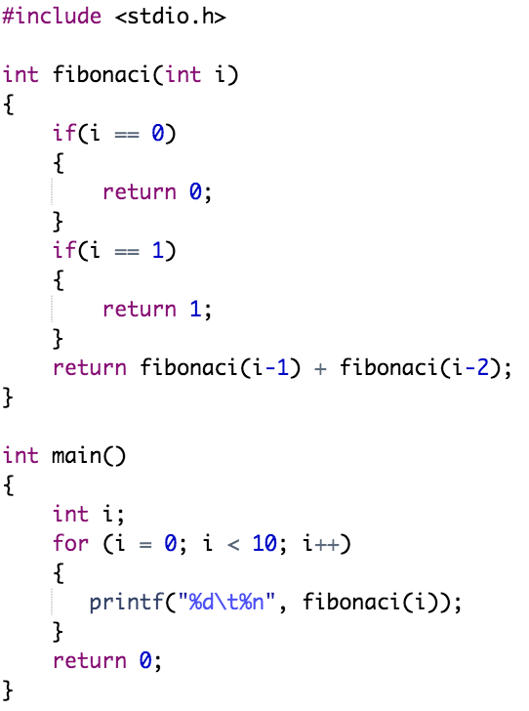
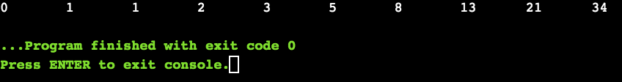
Recursion in C Programming
Example:

Slide 7
Outline
Recursion in C Programming
Divide by Zero Errors
Error Handling in C Programming
Global Variable errno
perror() and strerror()
Program Exit Status

Slide 8
Error Handling in C Programming
As such C programming does not provide direct support for error handling but being a system programming language, it provides you access at lower level in the form of return values
The error code errno indicates an error occurred during any function call
You can find various error codes defined in <error.h> header file
So, a C programmer can check the returned values and can take appropriate action depending on the return value
As a good practice, developer should set errno to 0 at the time of initialization of the program. A value of 0 indicates that there is no error in the program

Slide 9
Outline
Recursion in C Programming
Divide by Zero Errors
Error Handling in C Programming
Global Variable errno
perror() and strerror()
Program Exit Status

Slide 10
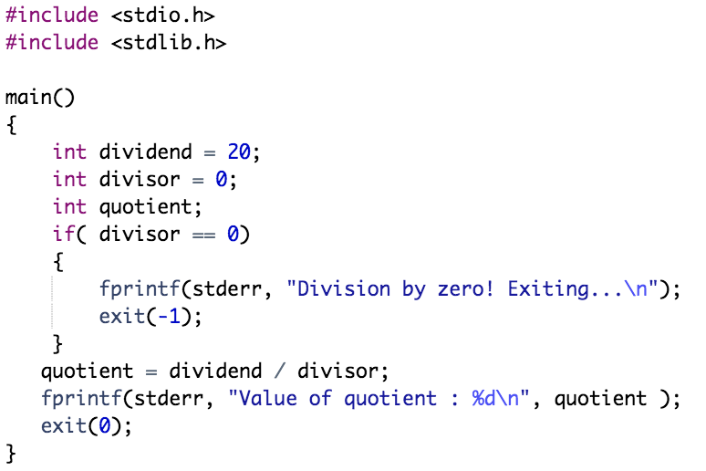
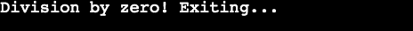
Divide by Zero Errors
It is a problem that at the time of dividing any number, programmers do not check if a divisor is zero and it creates a runtime error. The code below fixes this by checking if the divisor is zero before dividing

Slide 11
Outline
Recursion in C Programming
Divide by Zero Errors
Error Handling in C Programming
Global Variable errno
perror() and strerror()
Program Exit Status

Slide 12
Global Variable errno
When a function is called in C, a variable named as errno is automatically assigned a code (value) which can be used to identify the type of error that has been encountered
It is a global variable indicating the error occurred during any function call and defined in the header file errno.h
Different codes (values) for errno mean different types of errors

Slide 13
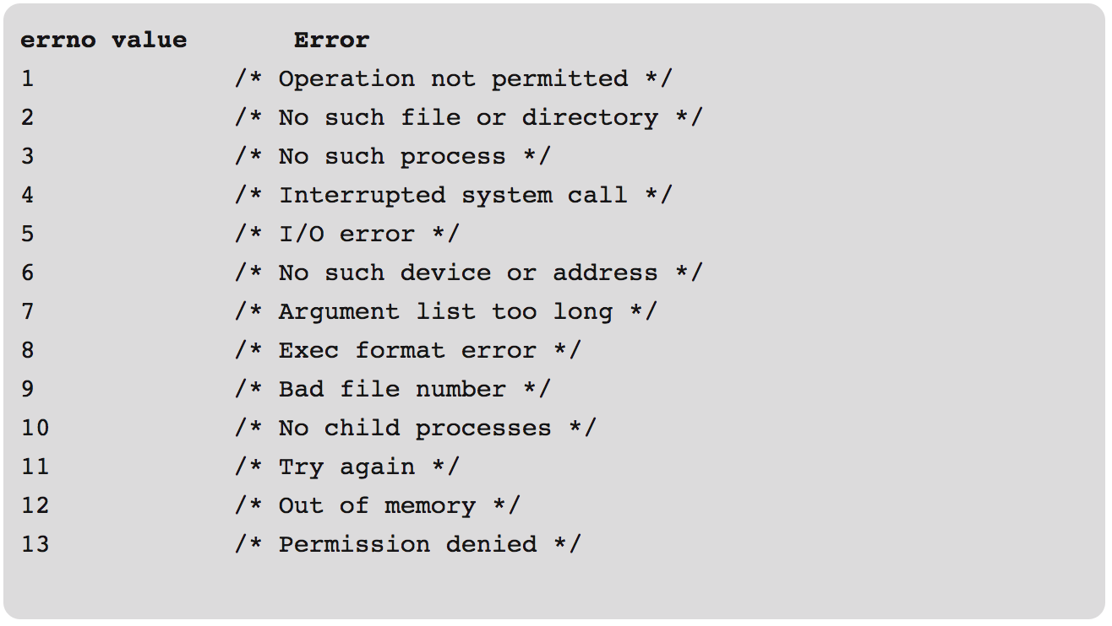
Global Variable errno
Below is a list of few different errno values and its corresponding meaning:

Slide 14
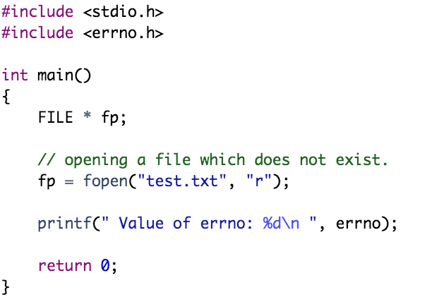
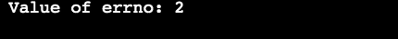
Global Variable errno
Example: Open a file that does not exist
Here, the errno is set to 2 which means – No such file or directory

Slide 15
Outline
Recursion in C Programming
Divide by Zero Errors
Error Handling in C Programming
Global Variable errno
perror() and strerror()
Program Exit Status

Slide 16
perror() and strerror()
The errno value indicates the types of error encountered
If it is required to show the error description, then there are two functions that can be used to display a text message that is associated with errno
The functions are:
The perror() function displays the string you pass to it, followed by a colon, a space, and then the textual representation of the current errno value
The strerror() function, which returns a pointer to the textual representation of the current errno value

Slide 17
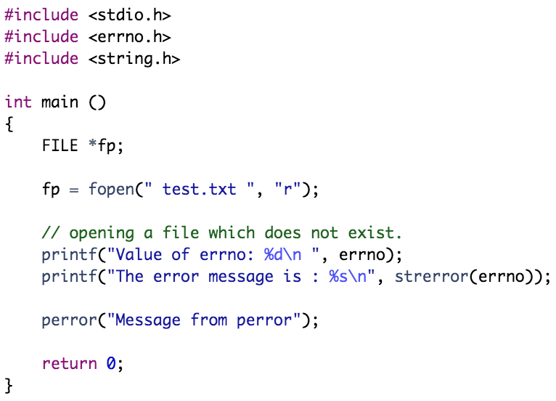
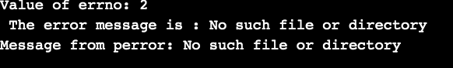
perror() and strerror()
Example: Open a file that does not exist

Slide 18
Outline
Recursion in C Programming
Divide by Zero Errors
Error Handling in C Programming
Global Variable errno
perror() and strerror()
Program Exit Status

Slide 19
Program Exit Status
The C standard specifies two constants: EXIT_SUCCESS and EXIT_FAILURE
Both may be passed to exit() to indicate successful or unsuccessful termination
These are macros defined in stdlib.h

Slide 20
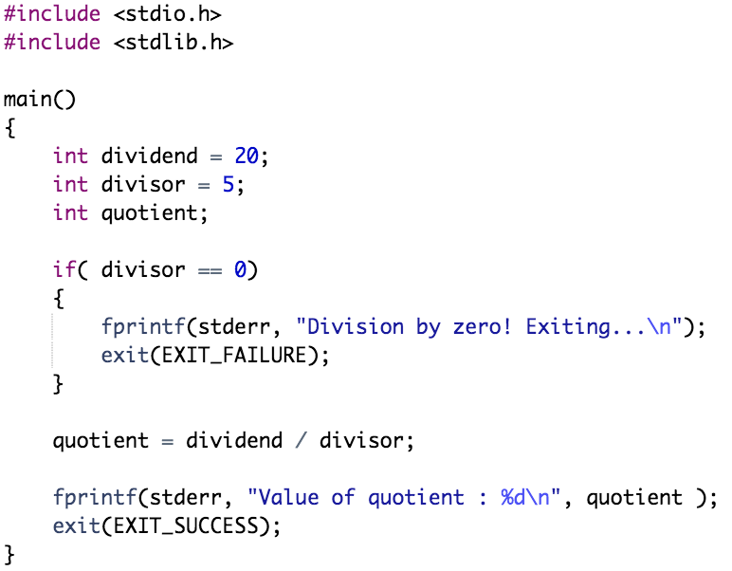
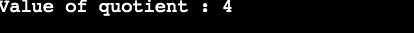
Program Exit Status
Example:

Slide 21
Practical Exercises
Write and Compile the following C programs:
Program 1:

Slide 22
Practical Exercises
Write and Compile the following C programs:
Program 2:

Slide 23
Practical Exercises
Write and Compile the following C programs:
Program 3:

Slide 24
Practical Exercises
Write and Compile the following C programs:
Program 4:

